Slide 1
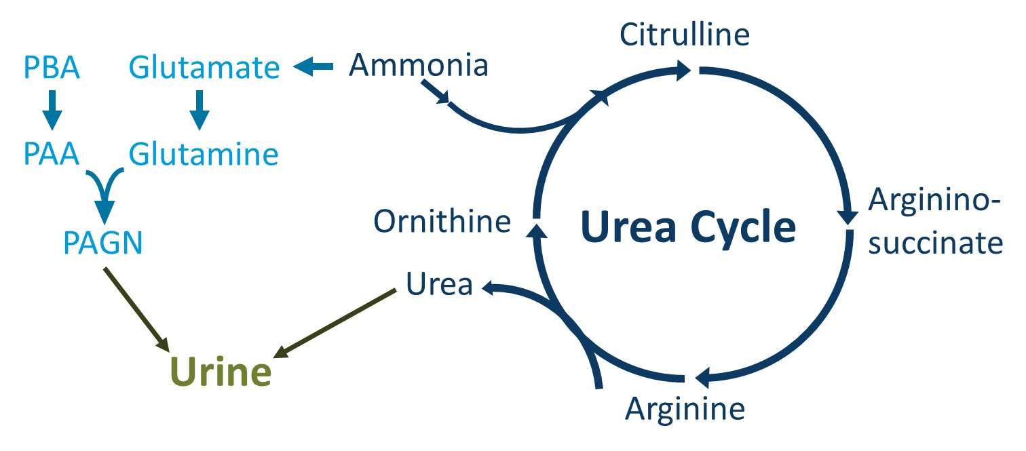
ADMINISTRATION OF A DUAL-COATED SODIUM PHENYLBUTYRATE (OLPRUVA) SUSPENSION VIA GASTROSTOMY TUBE
Lauren Hitchins, DNP¹, Chirstopher Lauderback PhD¹, Blair Orr, PhD¹, Adrian Quartel, MD¹
1. Zevra Therapeutics, Celebration, FL, USA
BACKGROUND
Urea Cycle Disorders (UCDs) are a group of inborn errors of metabolism characterized by hyperammonemia, which can lead to serious CNS toxicities. Treatment for UCDs often includes a protein-restricted diet, essential amino acid supplementation and nitrogen-scavenging therapy to reduce blood ammonia levels.
Due to the complex treatment needs of UCD patients, gastrostomy tubes may be necessary to ensure sufficient energy and protein intake.
Because gastric tubes play a critical part of the UCD management plan for some patients, gastrostomy tube administration studies were completed with Olpruva, a dual-coated formulation of sodium phenylbutyrate, to evaluate whether the medication can be effectively given via gastrostomy tubes.
METHODS
PBA: phenylbutyrate, PAA: phenylacetic acid, PAGN: phenylacetylglutamine.
In-vitro administration studies, including a 30 minute in-hold stability evaluation, were performed to assess feasibility of administering Olpruva via enteral feeding tubes.
Tube size was selected based off preliminary visual passage studies (Table 1). Additional studies were conducted with OLPRUVA administration through gastrostomy tubes. The acceptance criteria for the administered dose is 90-110% label claim
RESULTS
Potency analysis evaluated the recovered amount of sodium phenylbutyrate in the pre-rinse, dose preparation and post-rinse phases (Table 3).
Results showed that the dose of sodium phenylbutyrate that was recovered after administration through gastrostomy tubes met acceptance criteria in all the gastrostomy tubes at the evaluated doses and volumes of administration.
Table 1. Feeding Tube Selection and Visual Results
Table 3. In-vitro Administration Study Results of OLPRUVA Recovery at Time Points after Gastrostomy Tube Administration
Feeding Tube Typeª | Target Population | Size (Gauge) | Preliminary Visual Result
Nasogastric | Infant^{b} | 6 French | Clogged
Gastrostomy | Infant^{b} | 12 French | Passed Through
Gastrostomy | Pediatric Adolescent | 14 French | Passed Through
Gastrostomy | Adult | 16 French | Passed Through
Intended Patient Population | Gastrostomy Tube Size (Gauge) | Dose (grams)ª | Result (%Recovered)^{b}
Adult | 16 French | 2 | 99
 | 16 French | 6.67 | 98
Pediatric-Adolescent | 14 French | 2 | 99
 | 14 French | 6.67 | 99
ª Feeding tube selection was determined by a dietitian familiar with urea cycle disorder patient treatment
^{b} OLPRUVA is not indicated for the acute or chronic treatment of urea cycle disorders in infants
ª The dosages evaluated the minimum and maximum active dose of OLPRUVA
^{b} The acceptance criteria for the administered dose is 90-110% label claim
Volume of the administration vehicle , OLPRUVA doses, and phasing of administration through the gastrostomy tube were prepared to mimic both a pediatric and adult patient profile (Table 2).
Administered doses were prepared in a separate container by adding OLPRUVA (2 or 6.67g doses) to the administration vehicle volume (4 oz [120 ml] water + 3.1 grams Mix-Aid). The suspensions were stirred gently, then transferred through the gastrostomy tube and into the volumetric flasks within 5 minutes, followed by a post-rinse with the administration vehicle
Results of the In-use hold stability study found that all assay values for OLPRUVA and the impurities were within the accepted criteria (Table 4).
Table 4. Results from the In-use Hold Stability Study:
Amount of Sodium Phenylbutyrate and Related Substances Recovered after Holding OLPRUVA in Gastrostomy Tubes for 30 minutesª
Age Group – Tube Size |  |  | Adult – 16 French |  |  |  |  |  |  |  | Pediatric Adolescent – 14 French
OLPRUVA Dosage Strength (grams of NaPB) |  |  | 2 |  |  |  | 6.67 |  |  |  | 2 |  |  |  | 6.67
Test | Acceptance Criteria |  | 0 min |  | 30 min |  | 0 min |  | 30 min |  | 0 min |  | 30 min | 30 min | 0 min | 30 min
Assay by HPLC[%] | 90-110% |  | 100 |  | 99 |  | 99 |  | 98 |  | 100 |  | 99 | 99 | 99 | 99
Impurities by HPLC [%]^{b}
Impurity A |  | <0.1% |  | <0.01% | <0.01 | <0.01% |  | <0.01% |  | <0.01% | <0.01 | <0.01% |  | <0.01% | <0.01% | <0.01%
Impurity B |  | <0.01% |  | <0.01% | <0.01 | <0.01% |  | <0.01% |  | <0.01% | <0.01 | <0.01% |  | <0.01% | <0.01% | <0.01%
Each Individual Unknown |  | <0.1% |  | <0.01% | <0.01 | <0.01% |  | <0.01% |  | <0.01% | <0.01 | <0.01% |  | <0.01% | <0.01% | <0.01%
Table 2. Volume and Frequency of OLPRUVA Administration Vehicle Across Two Evaluated Patient Populations
 | Volume (mL) and Frequence of the Administration Vehicle
Phase of Administration | Pediatric Adolescent | Adult
Pre-rinse | 25 mL x 1 | 25 mL x 1
Dose preparation | 25 mL x 1 | 25 mL x 1
Post-rinse | 25 mL x 3 | 25 mL x 3
A hold study was conducted to evaluate in-use stability, with OLPRUVA in the prepared administration vehicle held in contact with the gastrostomy tube for 30 minutes.
CONCLUSION
HPLC, high performance liquid chromatography; NaPB, sodium phenylbutyrate
ª The pre-rinse, administration, and post-rinse followed the same dosages and volumes outlined in Table 1, but the prepared suspension was held in the gastrostomy tube for 30 minutes before being transferred into volumetric flasks, followed by the post-rinse
^{b} Limit of quantitation for Impurity A, Impurity B, and each individual unknown impurity is 0.01%
An in-vitro administration study and an in-hold stability study showed that OLPRUVA met the acceptance criteria for feasibility with gastrostomy tube administration.
This model of in-vitro analysis of passage of OLPRUVA through a gastrostomy tube may serve as a model for future studies to be conducted for other pharmacological products to ensure safe administration via gastrostomy tubes, which is likely an understudied area in metabolic diseases.
References:
1. Data on File. Acer Therapeutics, Inc., a wholly owned subsidiary of Zevra Therapeutics, Inc.
2. OLPRUVA® (sodium phenylbutyrate) for oral suspension. Prescribing Information. Newton, MA; Acer Therapeutics, Inc., a wholly owned subsidiary of Zevra Therapeutics, Inc. 2022
42nd Annual SERGG Meeting July 17-19, 2025 Asheville, North Carolina

