Slide 1
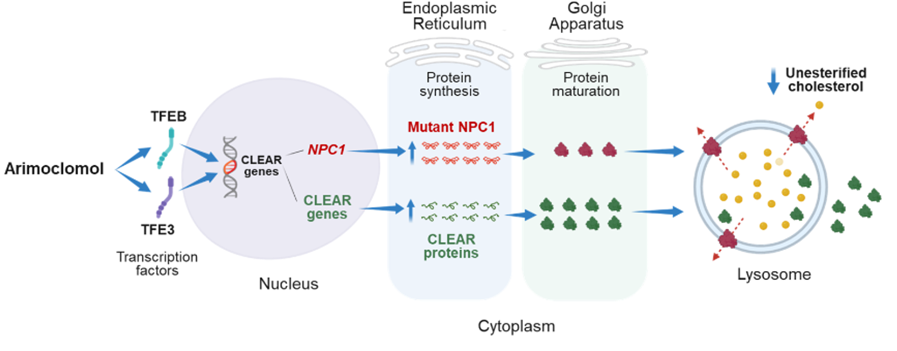
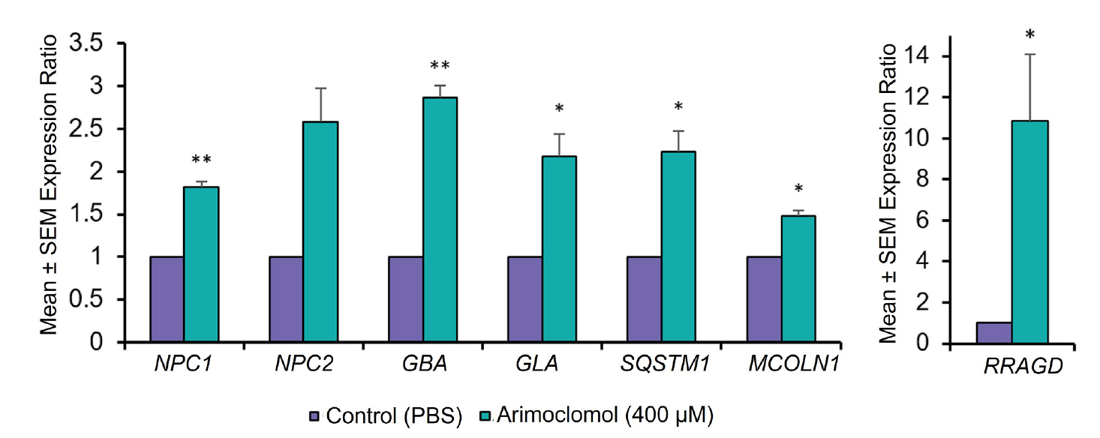
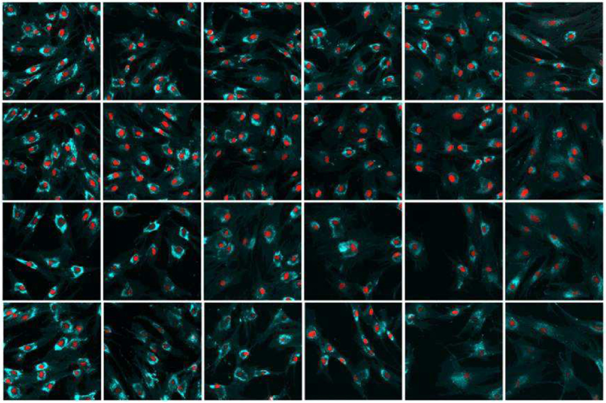
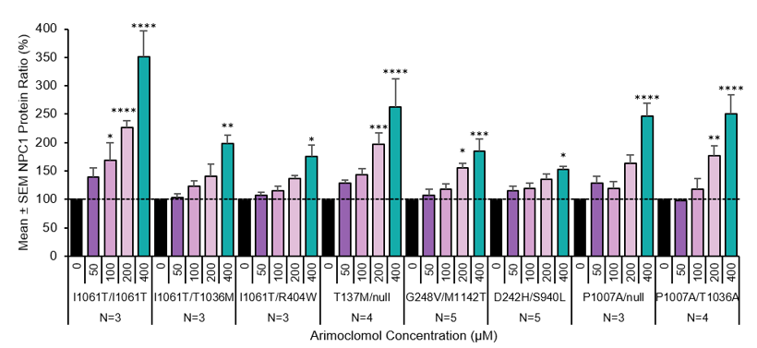
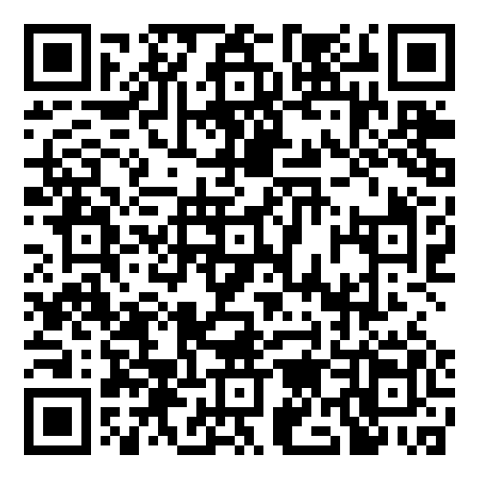
Arimoclomol Upregulates Expression of Genes Belonging to the Coordinated Lysosomal Expression and Regulation (CLEAR) Network
Hadeel Shammas¹, Nikolaj Havnsøe Torp Petersen², Pontus Klein², Anja Koustrup², Marianne Terndrup Pedersen², Anne Sigaard Bie², Travis Mickle¹, Cathrine Kolster Fog², Thomas Kirkegaard Jensen², Sven Guenther¹, Elena Buglo¹
¹Zevra Therapeutics, Orlando, FL, USA, ²Orphazyme A/S, Copenhagen, Denmark
BACKGROUND AND OBJECTIVE
Figure 1: Arimoclomol targets the pathophysiology of Niemann-Pick disease type C by two pathways
CONCLUSIONS
Niemann-Pick disease type C (NPC) is an ultra-rare and fatal neurodegenerative disease (1:100,000 live births). It is a highly heterogeneous disease with relentlessly progressive symptoms.
In NPC, normal lysosomal function is disrupted by mutations in the NPC1 (95% of cases) or NPC2 genes.
The dysfunction of either of these genes results in a reduced amount of properly folded and mature NPC protein, or even a complete lack of NPC protein.
The consequence is lysosomal dysfunction with accumulation of unesterified cholesterol in lysosomes and late endosomes which is toxic to the cell and causes neurodegeneration and peripheral organ dysfunction.
Arimoclomol, an orally available small molecule, is an FDA-approved treatment for NPC when used in combination with miglustat.
The purpose of the in vitro studies was to explore the pathways by which arimoclomol targets the pathophysiology of NPC.
The presented in vitro data provide mechanistic evidence of how arimoclomol can target NPC through multiple mechanistic pathways making it relevant in NPC.
Increased translocation of the transcription factors TFE3 and TFEB from the cytosol to the nucleus is a crucial step that results in upregulation of a series of downstream processes that may improve lysosomal function and cell viability.
Overall, the data support that arimoclomol does not only upregulate expression of certain CLEAR genes and specifically NPC1 at the transcriptional level, but also that this overexpression results in amplification of NPC1 protein levels and more successful NPC1 processing ultimately leading to increased cholesterol clearance from the lysosomal compartments.
The effects of arimoclomol in mutant NPC cells found across the in vitro studies are consistent, and downstream effects expected to result from the activation of a specific process in one study could be confirmed in another study to provide a cohesive picture of the mechanism of action of arimoclomol.
RESULTS
1
2
3
4
RESULTS
Figure 2: Transcription upregulation of selected CLEAR network genes after arimoclomol treatment in wild type fibroblasts
Arimoclomol activates transcription factors leading to upregulation of the CLEAR network genes including
NPC1 gene¹
These genes then express more of the NPC1 protein as well as the other proteins belonging to the CLEAR network¹
This results in amplification of NPC1 protein levels and more successful NPC1 processing ultimately leading to increased cholesterol clearance¹
Therefore, arimoclomol works through two pathways to improve autophagy, reduce cholesterol accumulations and prevent cell death¹
Figure 4: Effect of arimoclomol on the clearance of cholesterol in human NPC fibroblasts
0µM
12µM
Anmoclomol Concentration (µM)
25µM
50µM
100µM
200µM
7 days
RESULTS
14 days
Relative gene expression following 5-day treatment with 400 nM arimoclomol vs control (PBS). Left: NPC1, NPC2, GBA, GLA, SQSTM1, and MCOLN1 (values on left y-axis). Right: RRAGD (shown separately as the expression rate was markedly higher compared to the other genes).
Gene quantification was performed by quantitative RT-PCR. Treatment effects were evaluated by a paired 2-tailed t-test: *p < 0.05, **p < 0.01.
CLEAR = coordinated lysosomal expression and regulation; GBA = β-glucosylceramidase; GLA = α-galactosidase; MCOLN1 = mucolipin TRP cation channel 1; NPC1/ 2 = NPC intracellular cholesterol transporter 1/2; PBS = phosphate buffered saline; RRAGD = Ras related GTP binding D;
RT-PCR = reverse transcription quantitative polymerase chain reaction; SEM = standard error of the mean; SQSTM1 = sequestosom.
The results presented below outlines how arimoclomol can target NPC etiology through multiple mechanistic pathways making it relevant both when NPC is caused by functional null mutations and missense mutations. The proposed mechanism of action of arimoclomol is illustrated in Figure 1.
Transcriptional upregulation with arimoclomol (400 μM) was observed for all tested CLEAR genes related to lysosomal function (NPC1, NPC2, GBA, GLA, MCOLN1, RRAGD, SQSTM1) in healthy human fibroblasts (Figure 2).
After 1 day of treatment with arimoclomol, the translocation of TFE3 from the cytosol to the nucleus was significantly increased compared to vehicle in both healthy human and NPC patient fibroblasts across 3 genotypes containing either the I1061T or P1007A mutation (data not shown).
Arimoclomol (0–400 μM) increased NPC1 protein concentrations in all genotypes in a dose-dependent manner with the greatest effects observed in the I1061T/I1061T genotype (Figure 3).
A dose-dependent (0–400 μM) arimoclomol-enhanced translocation of TFE3 and TFEB from the cytosol to the nucleus was demonstrated in HeLa cells treated with the NPC1 protein inhibitor U-18666A that induces an NPC like phenotype (data not shown). The results show that the impaired function of NPC1 protein alone promote some translocation of TFE3/TFEB to the nucleus indicating that the NPC phenotype is more sensitive to TFE3/TFEB activation by arimoclomol.
Treatment with arimoclomol (400 μM) was shown to significantly enhance the binding of TFE3 to the CLEAR promoter elements of NPC1, NPC2, GBA, MCOLN1, and GLA in healthy human fibroblasts, whereas binding of TFE3 to the negative control ACTB promoter was not affected by arimoclomol (data not shown).
Arimoclomol (100 and 200 μM) increased the cholesterol clearance from the lysosomal compartment demonstrated by reduced filipin staining intensity at prespecified timepoints (7, 14, 21, 28 days), with the most pronounced effect obtained with the highest arimoclomol dose (Figure 4).
GM18453: 11061T/11061T
Figure 3: Arimoclomol increases the concentration of NPC1 protein across all tested NPC1 genotypes in human NPC fibroblasts
21 days
28 days
Microscopic pictures of filipin staining intensity in lysosomal compartment following arimoclomol treatment. Unesterified cholesterol levels were measured via high-content imaging of filipin staining in lysosomal compartments of NPC (GM18453, I1061T/I1061T).
Cells were treated with 0, 12, 25, 50, 100, or 200 nM arimoclomol for 7, 14, 21, or 28 days. Data represent means of medians from three replicate experiments (>1400 cells/condition) and are expressed as % reduction in staining intensity relative to vehicle control (0 nM).
Representative filipin-stained images (cyan, cholesterol) and DRAQ5-stained nuclei (red).
DISCLOSURES
HS is a current employees of Zevra Therapeutics.
This work was sponsored by Zevra Therapeutics. KemPharm acquired all assets and operations of Orphazyme, including arimoclomol, on June 01, 2022. Effective February 22, 2023, KemPharm changed its company name to Zevra Therapeutics.
Data are presented as the mean change in % + SEM of NPC1 protein expression after arimoclomol treatment for 5 days, relative to PBS-treated control cells from a total of 3 to 5 independent experiments. NPC1 levels have been normalized to tubulin for 1061T/I1061T and P1007A/null, and to ponceau staining of total protein for the other cell lines. *p<0.05, **p<0.01, ***p<0.001, ****p<0.0001.
METHODS AND STATISTICS
REFERENCES
For the full Results including data not shown on the present poster, detailed description of Methods and Statistic, and Supplementary Data, please scan this QR code to the full article.
Shammas H, Fog CK, Klein P, Koustrup A, Pedersen MT, Bie AS, Mickle T, Petersen NH, Jensen TK, Guenther S. Mechanistic insights into arimoclomol mediated effects on lysosomal function in Niemann-pick type C disease. Molecular Genetics and Metabolism. 2025 May 1;145(1):109103.
MIPLYFFA Full Prescribing Information. Celebration, FL, US, Zevra Therapeutics, Inc.; 09/2024
42nd Annual SERGG Meeting July 17-19, 2025 Asheville, North Carolina
This poster was prepared by Zevra Therapeutics

