Slide 1
Safety and Efficacy of KP1077 in a Phase 2,
Double-blind, Randomized Withdrawal Study in Patients with Idiopathic Hypersomnia
Rene Braeckman¹, Christopher Drake², Sven Guenther¹, Daniel Gallo¹, Ben Vaughn³, Ihab Abdel Fattah³
¹ Zevra Therapeutics, Celebration, FL, USA, ² Henry Ford Health, Detroit, MI, USA, ³ Rho, Durham, NC, USA
Poster P771 at Sleep Europe 2024, Seville, Spain,
Neurology Poster Session on September 26, 2024

Slide 2
Introduction
KP1077 is under development as an oral medication for the treatment of rare sleep disorders with Excessive Daytime Sleepiness (EDS), including idiopathic hypersomnia (IH).
The active ingredient in KP1077 is serdexmethylphenidate (SDX), a prodrug of d-methylphenidate (d-MPH).
SDX is converted to d-MPH in the lower intestinal tract resulting in a product with a unique pharmacokinetic profile defined by a delayed onset and extended duration kinetics.
Peak exposure of SDX-derived d-MPH after a nighttime dose of SDX occurs during the next morning leading to higher exposure at awakening compared to a morning dose.
To assess the safety (primary endpoint) and efficacy of KP1077 in patients with IH.
The trial was not powered to show statistical significance for any endpoint.
Objectives

Slide 3
Study Design
Open-Label
Titration
Period
Double-Blind
Randomized
Withdrawal
Period
Treatments:
4 dose levels: 80, 160, 240, and 320 mg/day
Dosing regimens:
QD: total daily dose just before bedtime
BID: half the daily dose just before bedtime + half shortly after awaking in the morning
Weeks 1-5: titration to optimal dose based on individual tolerability and response
Weeks 6-7: optimized dose of KP1077 or placebo
KP1077 QD
(N=32)
KP1077 QD
(N=16)
Placebo QD
(N=7)
KP1077 BID
(N=34)
KP1077 BID
(N=19)
5 weeks
Placebo BID (N=8)
2 weeks
Randomization to active drug or placebo (2:1 ratio)
QD = once per day
BID = twice per day
N = actual number of patients enrolled in each period

Slide 4
Results - Safety
KP1077 was well-tolerated in both dosing regimens and all dose levels, with most frequent AEs of insomnia, headache, anxiety, decreased appetite and nausea (Table 1).
Most AEs occurred in the titration period, were mild and did not lead to early discontinuation.
AEs of insomnia occurred mainly during the first week of treatment, at the lowest dose, and the incidence did not appear dependent on dose or dosing regimen. AEs of insomnia were often transient, not leading to discontinuation and allowed titration to higher doses. No insomnia AEs were reported in the DB withdrawal period.

Slide 5
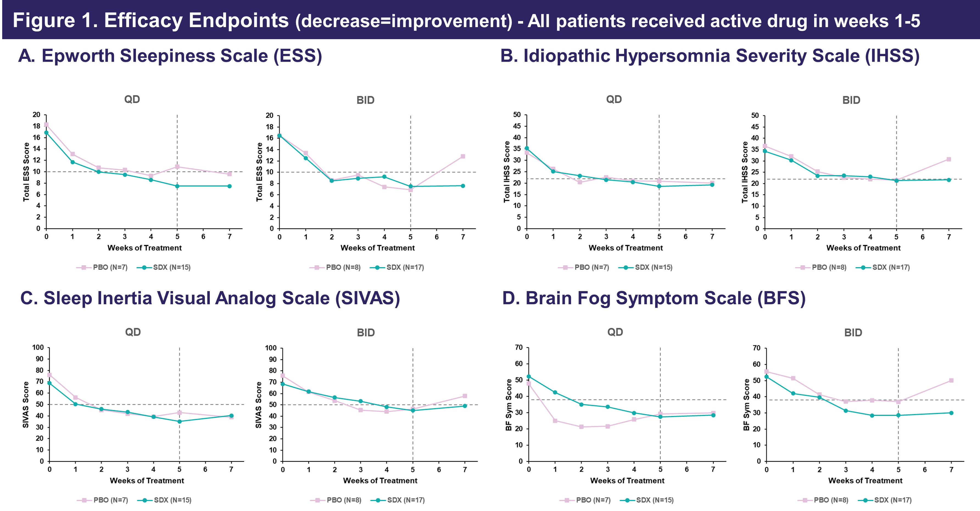
Results - Efficacy

Slide 6
Results - Efficacy
Clinically meaningful improvements in scores of ESS, IHSS, SIVAS, and BFS were seen over the 5-week titration period for in dosing regimens and were maintained in the 2-week DB withdrawal period (Figure 1).
Mean total ESS scores decreased by approximately 9 points after 5 weeks of OL treatment.
For the BID dosing regimen, an apparent separation from placebo (ESS difference of 5.9 points) was observed for the SDX treatment group at end of trial (Week 7) for all efficacy endpoints.
For the QD dosing regimen, no separation between treatment groups was seen at the end of the 2-week DB period since the placebo group on average did not worsen. This may be due to variability in the small number of patients.

Slide 7
Conclusions
KP1077 was well tolerated in patients with IH, with AEs typical for a central nervous system stimulant.
Meaningful clinical improvements of EDS, sleep inertia, and brain fog were observed after 5 weeks of OL KP1077 and were maintained during the 2-week DB withdrawal period. Results were similar for BID and QD dosing.
The results provide valuable information for the design of a potential Phase 3 study.
Disclosures: KP1077 is an experimental medication, not approved by any regulatory agency.
This study was funded by Zevra Therapeutics. CD is a consultant of Zevra, and the primary investigator of the trial. RB, DG, and SG are employees and shareholders of Zevra Therapeutics. BV and IAF are employees of Rho, the contract research organization that conducted the study.
Zevra Therapeutics thanks the participants and investigators who made this trial possible.
Conclusions
KP1077 was well-tolerated in patients with IH with AEs typical for a central nervous system stimulant.
Meaningful clinical improvements of EDS, sleep inertia and brain fog were observed after 5 weeks of OL KP1077 and were maintained during the 2-week DB withdrawal period. Results were similar for BID and QD dosing.
The results provide valuable information for the design of a potential Phase 3 study.

