Slide 1
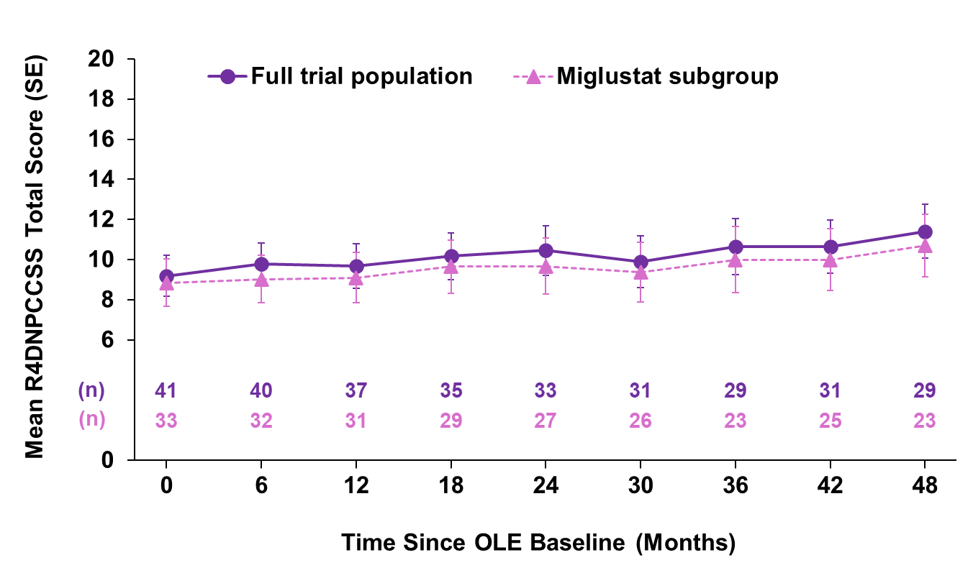
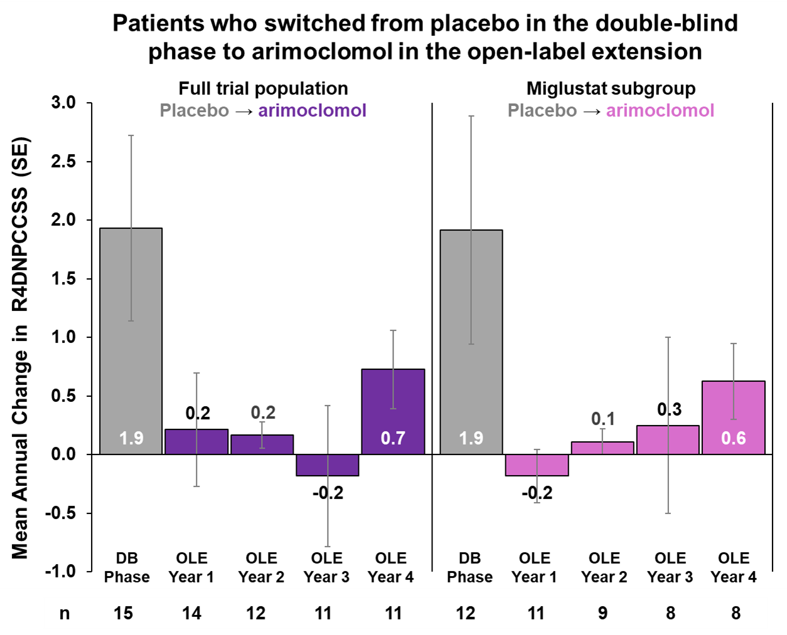
Long-Term Efficacy and Safety Evaluation of Arimoclomol
Treatment in Patients With Niemann-Pick Disease
Type C – Data From a 48-Month Open-Label Trial
Eugen Mengel ¹, Marc Patterson ², Sven Guenther ³, Christine í Dali ^{4,} Elena Buglo³
¹ SphinCS, Clinical Science for LSD, Hochheim, Germany, ² Neurology, Pediatrics and Medical Genetics, Mayo Clinic, Rochester, MN, USA,
³ Zevra Therapeutics, Celebration, FL, USA, ⁴ Zevra Denmark A/S, Frederiksberg, Denmark
BACKGROUND
CONCLUSIONS
Niemann-Pick disease type C (NPC) is an ultra-rare, autosomal recessive, progressive neurodegenerative lysosomal disease.
Clinical presentation is heterogeneous with declining neurological function.
Arimoclomol, an orally available small molecule, is the first FDA-approved treatment for NPC when used in combination with miglustat.
Results of a 12-month, randomized, double-blind (DB), placebo-controlled trial investigating the efficacy and safety of arimoclomol showed a positive benefit-risk in patients aged 2-18 years diagnosed with NPC.¹
Here we present long-term efficacy data and safety of up to 48 months of open-label extension (OLE) treatment with arimoclomol, introducing a rescored 4-domain NPC severity scale (R4DNPCCSS: ambulation, speech, swallowing, and fine motor; Score: 0 – 20).
The rate of disease progression in patients treated with arimoclomol was comparable between the DB phase and the OLE phase.
Arimoclomol was well tolerated with no new safety signals observed.
FIGURE 2. R4DNPCCSS OVER 48 MONTHS OF OPEN-LABEL EXTENSION WITH ARIMOCLOMOL
METHODS
Patients completing the DB phase were offered to continue into the OLE phase (NCT02612129).
The trial was conducted at 15 sites in 9 countries (US and EU).
Efficacy is presented as total R4DNPCCSS over the 48 months of the OLE.
For patients who received placebo during the DB phase and switched to arimoclomol in the OLE, the year-to-year change in R4DNPCCSS is presented.
Safety is described by frequency of adverse events (AEs) and severity.
*Stratified by miglustat use
# Observed values
FIGURE 1. NPC002 TRIAL DESIGN
FIGURE 3. MEAN ANNUAL CHANGE IN R4DNPCCSS FOR PATIENTS TREATED WITH PLACEBO DURING THE DB PHASE
12-month
Double-Blind Phase
Change from baseline to 12 months in R4DNPCSS#
4-year
Open-Label Extension (OLE)
Arimoclomol +
Routine Clinical Care
N = 34
Enrollment
N = 50
0.4
Arimoclomol +
Routine Clinical Care
N = 41
2:1*
Placebo +
Routine Clinical Care
N = 16
1.9
0
0.5
3
6
9
12
18
24
30
36
42
48
54
60
Study Visit (Month)
RESULTS
A total of 41 patients continued in the OLE phase (Figure 1), 29 patients completed.
Of the 12 patients withdrawn, 2 died due to disease progression, 2 discontinued due to safety, 2 were withdrawn by physician decision, and 6 withdrew consent.
The mean age was 12.2 (4.8) years at start of OLE phase, 80% were concomitantly treated with miglustat and baseline mean (SD) R4DNPCCSS was 9.2 (6.5).
During the DB phase patients treated with arimoclomol had a mean change from baseline in R4DNPCSS of 0.4 points vs. 1.9 for the placebo group (Figure 1).
In the OLE, the observed disease severity generally progressed slowly over the 48 months, with a stepwise progression pattern (Figure 2).
For patients who switched from placebo in the DB phase to arimoclomol in the OLE, the mean annual change decreased from 1.9 to 0.2 after starting treatment with arimoclomol and continued to be numerically smaller (potentially indicating slower disease progression) for the rest of the trial (Figure 3).
Similar observations were made for the subgroup of patients concomitantly treated with miglustat.
The overall pattern of AEs frequently reported were stable over the 48 months and consistent with observations in the DB phase of the trial.
The 3 most common AEs were diarrhea, upper respiratory tract infection, and nasopharyngitis (Table 2).
Table 2. Frequently Reported Adverse Events (>10%)
Preferred Term | Arimoclomol N = 41 n (%)
Diarrhea | 10 (24.4%)
Upper respiratory infection | 10 (24.4%)
Nasopharyngitis | 8 (19.5%)
Epilepsy | 8 (19.5%)
Corona virus infection | 8 (19.5%)
Seizure | 7 (17.1%)
Cough | 7 (17.1%)
Bronchitis | 7 (17.1%)
Weight decreased | 6 (14.6%)
Epistaxis | 6 (14.6%)
Constipation | 6 (14.6%)
Rhinitis | 5 (12.2%)
Influenza | 5 (12.2%)
Vomiting | 5 (12.2%)
Gastroenteritis | 5 (12.2%)
Eczema | 5 (12.2%)
N = number of patients in the extension analysis set; n = number of patients with event; % = percentage of patients with event
Table 1. Summary of Adverse Events
 | Arimoclomol N = 41 n (%)
Any AE | 38 (93%)
Severe AE | 15 (37%)
Serious AE | 15 (37%)
AE leading to treatment discontinuation | 4 (10%)
AE with fatal outcome | 2 (5%)
N = number of patients in the extension analysis set; n = number of patients with event; % = percentage of patients with event
REFERENCES
Mengel E, Patterson MC, Da Riol RM, et al. Efficacy and safety of arimoclomol in Niemann-Pick disease type C: Results from a double-blind, randomised, placebo-controlled, multinational phase 2/3 trial of a novel treatment. J Inherit Metab Dis. 2021;44(6):1463-1480. doi:10.1002/jimd.12428
42nd Annual SERGG Meeting July 17-19, 2025 Asheville, North Carolina
This poster was prepared by Zevra Therapeutics

